Slide 1
Python
Bootcamp 2021

Slide 2
Outline for today
Setup Anaconda
Running Python
Variables and Assignment
Data Type
Built-in functions
Conditionals
Loops

Slide 3
Outline for today
Setup Anaconda
Running Python
Variables and Assignment
Data Type
Built-in functions
Conditionals
Loops

Slide 4
Setup Anaconda

Slide 5
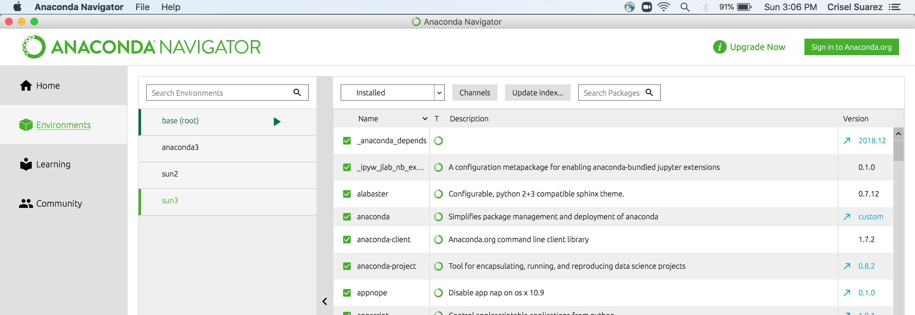
Setup Anaconda

Slide 6
Setup Anaconda
>On your bash shell
$ conda create --name bootcamp2021
proceed ([y]/n)?
Y
$ conda info --envs
$ conda env list
$ conda activate bootcamp2021
$ conda list -n bootcamp2021
$ conda install package-name
$ conda install package-name=2.3.4
https://conda.io/projects/conda/en/latest/user-guide/tasks/manage-environments.html
https://docs.anaconda.com/anaconda/user-guide/tasks/install-packages/
$conda create –name bootcamp2021 –clone base

Slide 7
Scripts /Spyder/Jupyter Notebook/JupyterLab
All have pros/cons
Choose what works best for you
It is okay to switch between platforms

Slide 8
Python Scripts
Run scripts on your bash shell
$python
>>>
>>>print(‘hello world’)
>>>exit() #Go back to your bash shell ($)
$ vim hello_world.py
print(‘hello world’)
$python hello_world.py
vim
Insert mode (i)
Type your script/notes
esc
:wq

Slide 9
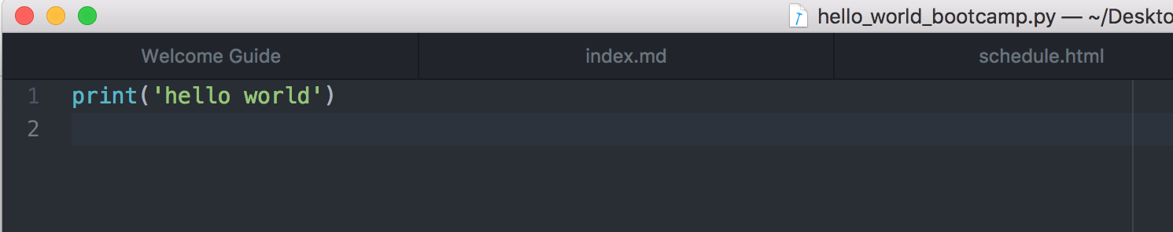
Python Scripts-Atom/Text Editor
On your bash shell
$python hello_world_bootcamp.py
hello world

Slide 10
Spyder
Declared
Variables
Script
Code
goes here
Output

Slide 11
Spyder
Run your code

Slide 12
Spyder
Debug your code
More on this later

Slide 13
Jupter Lab (.ipynb)
$ jupyter lab
Cell – Code
Output
To run a cell: shift + enter
https://jupyterlab.readthedocs.io/en/stable/user/notebook.html

Slide 14
Jupter notebook (.ipynb)
$ jupyter notebook
When in Command mode (esc/gray),
The b key will make a new cell below the currently selected cell.
The a key will make one above.
The x key will delete the current cell.
The z key will undo your last cell operation (which could be a deletion, creation, etc).
https://jupyter-notebook.readthedocs.io/en/latest/notebook.html

Slide 15
Jupter notebook (.ipynb)
Markdown great for commenting/adding notes to your code!
A simple plain-text format for writing lists, links, and other things that might go into a web page.
Turn the current cell into a Markdown cell by entering the Command mode (Esc) and press the M key.
In [ ]: will disappear to show it is no longer a code cell and you will be able to write in Markdown.
Turn the current cell into a Code cell by entering the Command mode (Esc) and press the y key

Slide 16
Markdown – html
* Use asterisks
* to create
* bullet lists.
Lists
# A Level-1 Heading
Headings
## A Level-2 Heading (etc.)
[Create links](http://software-carpentry.org) with `[...](...)`.
Or use [named links][data_carpentry]. [data_carpentry]: http://datacarpentry.org
urls + links

Slide 17
Outline for today
Setup Anaconda
Running Python
Variables and Assignment
Data Type
Built-in functions
Packages
Conditionals
Loops

Slide 18
Variables and Assignments
In Python the = symbol assigns the value on the right to the name on the left
age = 42
my_name = ‘Crisel Suarez’
Grade1 = ‘A’
Variable names
can only contain letters, digits, and underscore _
cannot start with a digit
are case sensitive (age, Age and AGE are three different variables)

Slide 19
Variables and Assignments
first_name = ‘Kathy ’
age = 10
print(first_name, 'is', age, 'years old’)
Variables can be used in calculations:
new_age = age +10
Indexing
print(first_name[0]
*** Python indexing starts at 0 ***

Slide 20
Indexing and Slices
[start:stop]
atom_name = 'sodium’
print(atom_name[0:3])
> sod
len(atom_name)
6

Slide 21
Key Points
Use variables to store values.
Use print() to display values.
Variables persist between cells.
Variables must be created before they are used.
Variables can be used in calculations.
Use an index to get a single character from a string.
Use a slice to get a substring.
Use the built-in function len() to find the length of a string.
Python is case-sensitive.
Use meaningful variable names

Slide 22
Outline for today
Setup Anaconda
Running Python
Variables and Assignment
Data Type
Lists
Built-in functions
Packages
Conditionals
Loops

Slide 23
Data Types
str() – String
int()- integer
Float() - decimals
Type() > What kind of data type

Slide 24
Outline for today
Setup Anaconda
Running Python
Variables and Assignment
Data Type
Lists
Built-in functions
Packages
Conditionals
Loops

Slide 25
Lists
Storing multiple variables
pressures = [0.273, 0.275, 0.277, 0.275, 0.276]
print('pressures:', pressures)
print('length:', len(pressures))
print('zeroth item of pressures:', pressures[0])
pressures[0] = 0.265

Slide 26
Lists – Appending
list_name.append()
primes = [2, 3, 5]
print('primes is initially:', primes)
primes.append(7)
print('primes has become:', primes)

Slide 27
Lists – Deleting
del list_name[index] to remove an element from a list
primes = [2, 3, 5, 7, 9]
print('primes before removing last item:', primes)
del primes[4]
print('primes after removing last item:', primes)

Slide 28
List- Empty []
Empty_list = []
Helpful as a starting point for collecting values

Slide 29
Practice:
print('string to list:', list('tin’))
print('list to string:', ''.join(['g', 'o', 'l', 'd’]))
What does list do?
What does .join do?
*We will come back to list with Numpy’s version …arrays

Slide 30
Outline for today
Setup Anaconda
Running Python
Variables and Assignment
Data Type
Lists
Built-in functions
Conditionals
Loops

Slide 31
Built-in functions
Think math function
f(x) = x + 5
x -> input
f(x) -> output
Functions can take 0 or many arguments
print()
f(x1, x2, x3,…) = x1+ x2+x3 +…..

Slide 32
Built-in functions
max(1,2,3)
min(5,6,7)
round(3.712, 1) #rounds to 1 decimal place
help(round)

Slide 33
Functions attached to objects are called methods
Methods have parentheses like functions, but come after the variable.
my_string = 'Hello world!' # creation of a string object
print(my_string.swapcase())
# calling the swapcase method on the my_string object

Slide 34
Outline for today
Setup Anaconda
Running Python
Variables and Assignment
Data Type
Built-in functions
Conditionals
Loops

Slide 35
Conditionals
if (condition is True): then do something
if (condition is True): then do something
else:
Do something else
if (condition is True): then do something
elif (this condition is true):
then do this
else:
Do this

Slide 36
Conditionals – Try it out
mass = 3.4
If mass > 3.0:
print(‘Mass is ’ , mass)
if mass > 3:
print(‘Mass is less than 3’)
else:
print(‘Mass is more than 3’)
if mass < 3.7: print(‘mass less than 3.7’)
elif (if mass > 3.2 ):
print(‘mass greater than 3.2’)
else:
print(mass greater than 3.7 or
less than 3.2)

Slide 37
Conditionals – Try it out
mass = 3.4
If ((mass < 3.7) and (mass >3.2)):
print(mass less than 3.7 or
greater than 3.2)
mass = 3.4
If ((mass < 3.7) or (mass >3.2)):
print(mass less than 3.7 or
greater than 3.2
mass = 3.8
If ((mass < 3.7) and (mass >3.2)):
print(mass less than 3.7 or
greater than 3.2
mass = 3.8
If ((mass < 3.7) or (mass >3.2)):
print(mass less than 3.7 or
greater than 3.2

Slide 38
Conditionals

Slide 39
Loops
Setup Anaconda
Running Python
Variables and Assignment
Data Type
Built-in functions
Conditionals
Loops

Slide 40
Loops
Loops are a programming construct which allow us to repeat a command or set of commands for each item in a list. As such they are key to productivity improvements through automation
i | i<= 6 | Output
2 | True | 3
4 | True | 5
6 | True | 7
8 | False

Slide 41
Loops
Loops are a programming construct which allow us to repeat a command or set of commands for each item in a list. As such they are key to productivity improvements through automation

Slide 42
Loops
for number in [2, 3, 5]:
print(number)
primes = [2, 3, 5]
for p in primes:
squared = p ** 2
cubed = p ** 3
print(p, squared, cubed)

Slide 43
Loops
The built-in function range produces a sequence of numbers.
Not a list: the numbers are produced on demand to make looping over large ranges more efficient.
print('a range is not a list: range(0, 3)’)
for number in range(0, 3):
print(number)

Slide 44
Loops – Practice
# List of word lengths: ["red", "green", "blue"] => [3, 5, 4]
lengths = ____
for word in ["red", "green", "blue"]:
lengths.____(____)
print(lengths)

Slide 45
Loops – Practice
# List of word lengths: ["red", "green", "blue"] => [3, 5, 4]
lengths = []
for word in ["red", "green", "blue"]:
lengths.append(len(word))
print(lengths)

Slide 46
Loops – Practice
# Concatenate all words: ["red", "green", "blue"] => "redgreenblue”
words = ["red", "green", "blue"]
result = ____
for ____ in ____:
____
print(result)

Slide 47
Loops – Practice
# Concatenate all words: ["red", "green", "blue"] => "redgreenblue”
words = ["red", "green", "blue"]
result = ””
for word in words:
result = result+word
print(result)

